Slide 1
Practical Kotlin Author by laibao wang https://github.com/wanglaibao

Slide 2
Outline
One: Why we should learn Kotlin
Two: What can kotlin do
Three: The philosophy of Kotlin
Four: Kotlin Basic
Five: Kotlin in Action
Six: Spring Boot With Kotin in action

Slide 3
One: Why we should learn Kotlin
1: Created by JetBrains which is an famous IDE tools company
2: Google add Kotlin as an official programming language for
Android development at Google I/O 2017
3: Spring Ecology is introducing Kotlin Language support in Spring Framework 5.0
https://spring.io/blog/2017/01/04/introducing-kotlin-support-in-spring-framework-5-0
4:A bridge to learn FP such as Lisp and HasKell
[Structure and Interpretation of Computer]

Slide 4
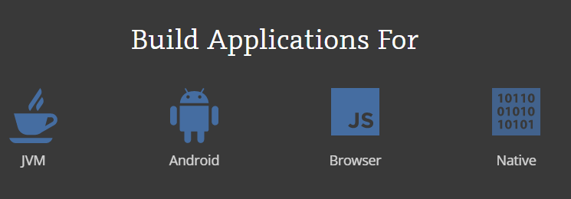
Two: What can kotlin do
1:Kotlin on the server side
2:Kotlin on Android
3:Kotlin JavaScript
4:Kotlin Native

Slide 5
Three: The philosophy of Kotlin
1: To be Practical
2: To be Concise
3: to be Safe
4: to be Interoperable with java freely

Slide 6
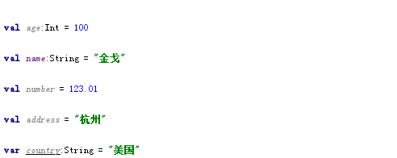
Four: Kotlin Basic
1: variable definition
In Kotlin,we declare a variable with two keywords:val and var.
val ——Immutable reference. A variable declared with val can’t be reassigned after it’s initialized. It equals to a final variable in Java.
var —— Mutable reference. The value of such a variable can be changed. This declaration equals to a regular (non-final) Java variable.

Slide 7
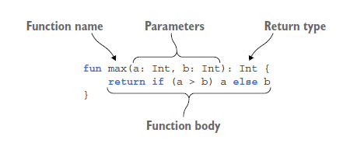
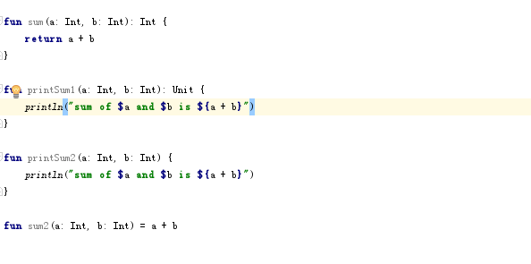
2:function definition
In Kotlin,the function definition starts with the fun keyword, followed by the function name and followed by the parameter list in parentheses. The return type comes after the parameter list, separated from it by a colon.

Slide 8
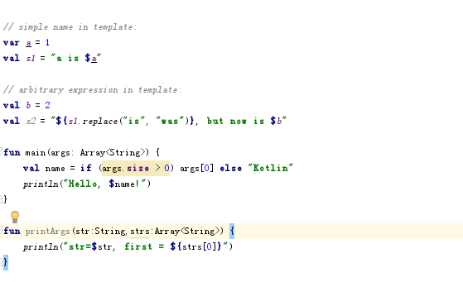
3:Easier string formatting: string templates
Kotlin allows us to refer to variables in string literals by putting the $ character in front of the variable name. This is equivalent to Java’s string concatenation but is more efficient.

Slide 9
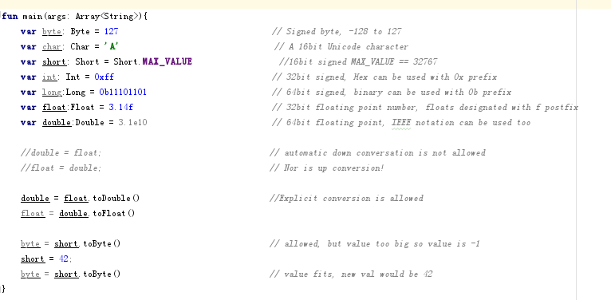
4:Numeric Types
Kotlin has several built in number types: Byte, Short, Int, Float, Long and Double. Bigger and smaller types share no relationship, so automatic conversation does not exist.We can not automatically assign a short to a byte, nor a byte to a short. we must call the appropriate to() method.

Slide 10
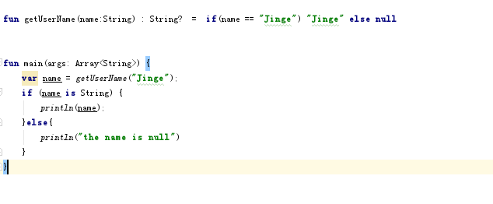
5:Nullable Types
In Kotlin, function can also return a null value, but need to be marked as such using the ? operator;to use the ? operator we can avoid the most notorious NPE from java.

Slide 11
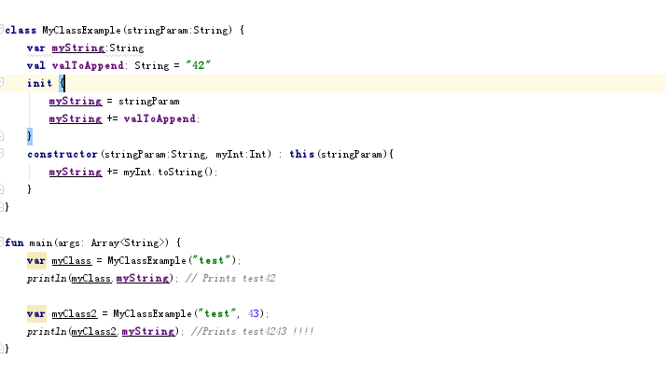
6:Class and Constructor
In kotlin, Class just as java has the class keyword,but has some difference.Kotlin has a primary constructor and some secondary constructor which use the constructor keyword,If we need to set initial values, we can do so in the init block.

Slide 12
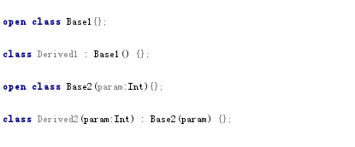
7:Calss Inheritance 1
The base class of all classes in Kotlin is Any, which is analogous to Object in Java. Inheritance looks almost exactly like Java.
The only major difference is the parent class is marked open, otherwise it would be marked final. If the base class has a constructor, you must call it in the derived class.

Slide 13
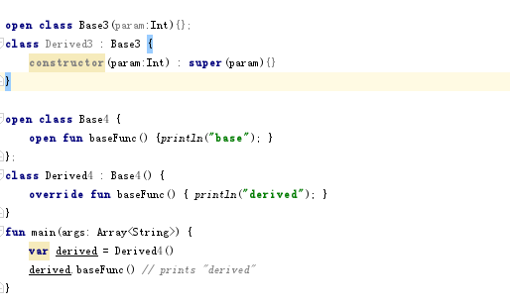
8:Calss Inheritance 2
If a derived class has no primary constructor then it’s secondary constructors need to call the base class using super keyword.
Method override must be done with a combination of open and override keywords.

Slide 14
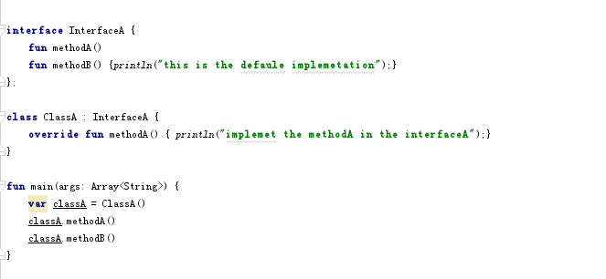
9: Interface in Kotlin
Interface in kotlin can contain both abstract method as well as non-abstract method,which has a default implements----just as the default method in java8 interface.

Slide 15
Five: Kotlin in Action
To learn Kotlin,Please start from command line!
To learn Kotlin,Please start from command line!
To learn Kotlin,Please start from command line!
1: talk about HelloKotlin.kt
2: to understand val and var keywords
3: interchange with java class
https://github.com/wanglaibao/ProgrammingWithKotlin

Slide 16
Six: Spring Boot With Kotin in action
1: How to BootStrap the Application
A: to use SpringBootKotlinDemoApplication and main function at the same top package
B: to use SpringBootKotlinDemoApplication and include main function [the error way]
C:to use SpringBootKotlinDemoApplication and accompany object [the prefect way!]
2: How to DI
A: to use primary constructor
B: to use kotlin lateinit
C: to combine both above
https://github.com/wanglaibao/kotlin-microservice-demo

Slide 17
Resource Online
https://kotlinlang.org/
https://blog.jetbrains.com/kotlin/
https://www.kotlincn.net/
https://kotlin.link

Slide 18
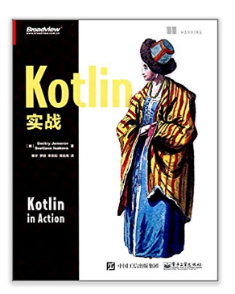
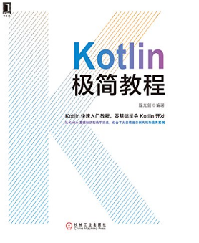
Books on Kotlin

Slide 19
Thank you

Slide 20
